Slide 1

My Data Interactive Notebook
Name
Class
Teacher
Semester 2
Term 3
1

Slide 2

Interactive Notebooks!
Cover Page
Contents Page
Glossary
24/7/30
EQ
Questions
Notes
Summaries
Work page
Presentation!!!
Your book, your responsibility!

Slide 3
Quickwrite
For 2 minutes, on the LHS of your INBs, write everything you know about Mean, Median, Mode and Range. This can include their definitions, examples, any confusions you have… The key is to keep writing for the whole 2 minutes.
After the 2 minutes is finished, turn to one of the people next to you and let them know what you wrote about. One partner starts, then the next after partner 1 is finished.

Slide 4
Most of the data we’ve been looking at has values that are close together. But what happens when we have unusual values? Consider the following set of values:
2, 3, 4, 5, 6, 6, 9, 68
Calculate the mean, median, mode and range for these values
Which of these measures is affected the most if we remove 68? Show all working out.

Slide 5

24
7
30
Measures of Location
Date
EQ – What are outliers and how do they affect the measures of location and spread we’ve learned about?
What are outliers?
Outliers are unusual values. When we see outliers, we need to find out:
Are they mistakes
Should we delete them
Let’s look at the problem on the last slide to find out how outliers affect the mean, median, mode and range
Summary:

Slide 6
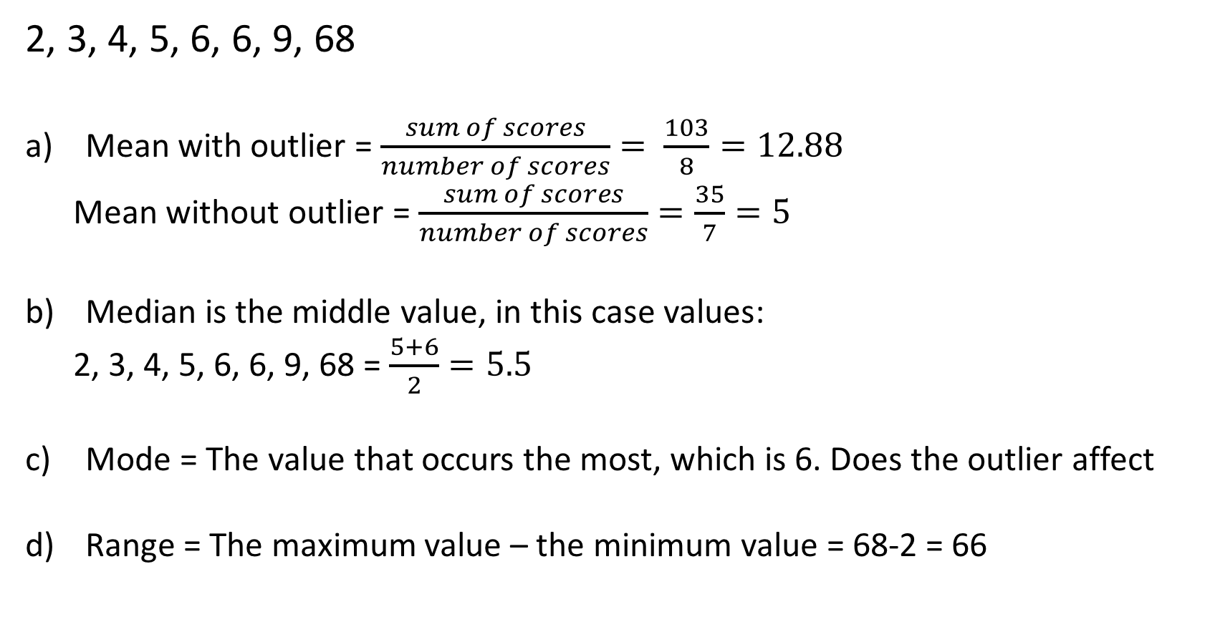
24
7
30
Measures of Location
Date
EQ – What are outliers and how do they affect the measures of location and spread we’ve learned about?
What are outliers?
2, 3, 4, 5, 6, 6, 9, 68
Mean with outlier = $\frac{sum of scores}{number of scores}= \frac{103}{8}=12.88$
Mean without outlier = $\frac{sum of scores}{number of scores}=\frac{35}{7}=5$
Median is the middle value, in this case values:
2, 3, 4, 5, 6, 6, 9, 68 = $\frac{5+6}{2}=5.5$
Mode = The value that occurs the most, which is 6. Does the outlier affect
Range = The maximum value – the minimum value = 68-2 = 66
Quite a difference

Slide 7
So, we can see that because the mean is an average of ALL values, it is heavily affected by outliers. But what about median, mode and range?
2, 3, 4, 5, 6, 6, 9, 68
Median – if we substituted 10 for 68, 5 and 6 would still be the middle values and the median would not change. So outliers do not affect the median
Mode – As mode is simply the value that occurs the most, the addition of an extreme value like 68 doesn’t change the fact that 6 is still the value that occurs the most. So outliers do not affect the mode.
Range – If we substitute 10 for 68, suddenly our range is much smaller, as 10-2 = 8, as opposed to 68-2 = 66. So outliers do affect range.

Slide 8
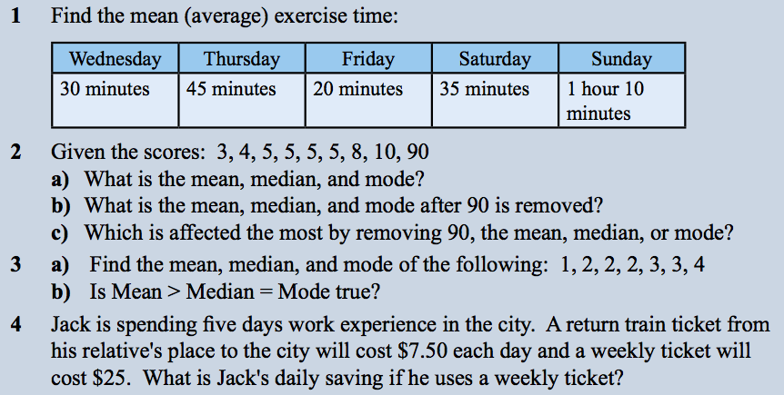
From last class, let’s revisit this question:

Slide 9
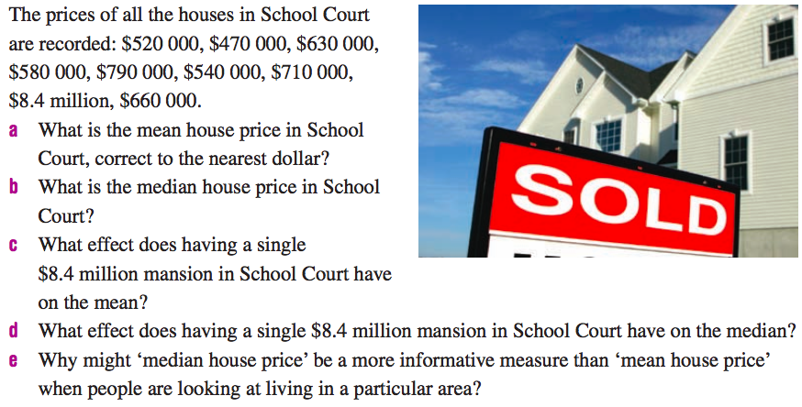
Applying what we’ve learned

Slide 10
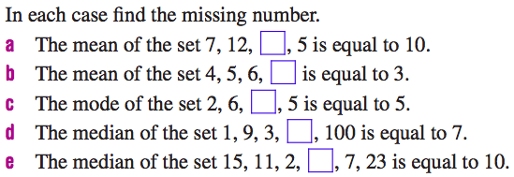
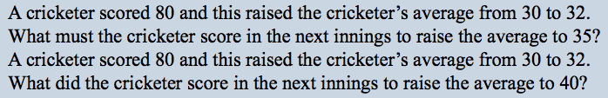
Extension

Slide 11
24
7
30
Measures of Location
Date
EQ – What are outliers and how do they affect the measures of location and spread we’ve learned about?
What are outliers?
Complete your Summary!!!
Summary:

Slide 12
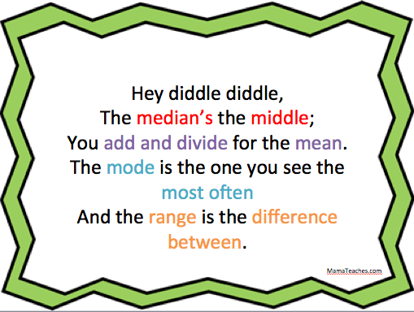
How can you remember all this?

Slide 13
Notes Review
24, 7 ,30
Date
Title
Essential question
Notes complete
Notes complete with colour and diagrams
Questions completed
Contents page filed in
Formula page filled in

